Slide 1
Handout-2(b)
Dr. R. Z. Khan
AMU. Aligarh (INDIA)

Slide 2
Why Objects?
A new way to think about software
Industrial revolution -- reuse software, not rewrite
Increase
  programmer productivity
  quality of software
  understandability of software
  lifetime of software

Slide 3
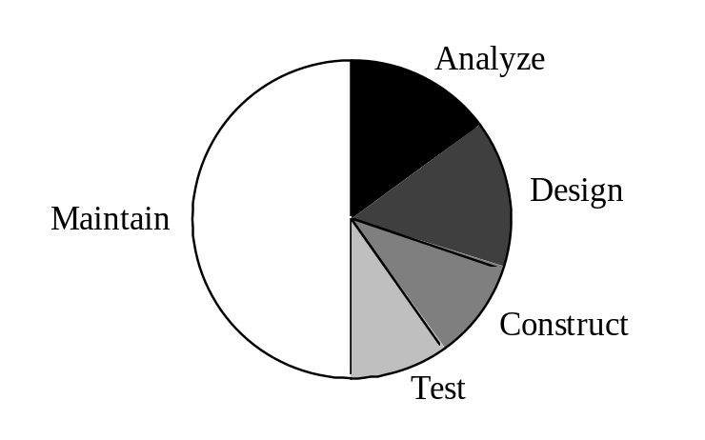
The Software Lifecycle
What is important?
maintainability
extensibility
understandability

Slide 4
Old Paradigm
Computer system consists of data and programs.
Programs manipulate data.
Programs organized by
  functional decomposition
  dataflow
  modules

Slide 5
New Paradigm
Computer system consists of a set of objects.
Objects are responsible for knowing and doing certain things.
Objects collaborate to carry out their responsibilities.
Programs organized by classes, inheritance hierarchies and subsystems

Slide 6
What is an object, anyway?
Mystical view
  Computing systems are made up of objects that communicate only by sending messages between each other. All computation is message sending.

Slide 7
What is an object, anyway?
Scandinavian view
  A program is a simulation. Each entity in the system being simulated is represented by an entity in the program.

Slide 8
What is an object, anyway?
Programming language view
  An object-oriented system is characterized by
    • data abstraction
    • inheritance
    • polymorphism by late-binding of procedure calls

Slide 9
Heart of Object-Oriented Programming
Don't make a new language, extend your old one.
Objects should be abstractions of problem domain.

Slide 10
Modeling
All phases of software life-cycle are modeling
  • analysis - modeling of problem
  • design - modeling of solution
  • implementation - making model run on a computer
  • maintenance - fixing/extending your model

Slide 11
Assumption about Modeling
Basing system design on structure of problem makes system
  • more reusable
  • more extensible

Slide 12
Modeling
Claim: people model the world with "objects"
  • objects
  • classes
  • relationships between objects
  • relationships between classes

Slide 13
Modeling
Advantages of object-oriented software development
  • more natural - matches the way people think
  • single notation - makes it easy to move between software phases

Slide 14
Objects and Relationships
John is Mary's father. Mary is John's daughter.
Bob is Mary's dog. Mary is Bob's owner.
Ann is John's employer. John is Ann's employee.

Slide 15
Objects and Attributes
John's name is "John Patrick O'Brian".
John's age is 27.
John's address is 987 N. Oak St, Champaign IL 61820
What about John's employer? John's wife?
What is an attribute, and what is a relationship?

Slide 16
Objects and Behavior
John goes on a trip.
John makes reservations.
John buys tickets.
John travels by airplane.
John checks into hotel.

Slide 17
What Really is an Object?
Reservation -- a promise to give service to a customer
Ticket -- proof that customer has paid for service in advance
Flight
Payment -- an event (transaction?) in which money is exchanged

Slide 18
What Really is an Object?
Anything we can talk about can be an object, including relationships ("the husband of the first party", "first-born son").
What are we trying to model?
Models should be as simple as possible, but no simpler.

Slide 19
Classification
We naturally put objects into classes that have similar characteristics.
  • John is a man.
  • Mary is a woman.
  • Bob is a dog.
  • All women are people.
  • All people are mammals.
Mammals
Dogs
People
Women
Men
Bob
Mary
John

Slide 20
Classification
  • John is an employee.
  • John is a father.
  • John is a sky-diver.
  • John is under 30.
Is John an instance of Employee, Father, Sky-diver, and Under30?

Slide 21
Summary
Objects
• have identity
• have attributes
• have behavior
• have relationships with other objects

Slide 22
Summary
Classes
• describes the attributes, behavior, and relationships of a set of objects
• subclasses/superclasses form graph of generalizations

